Slide 1
The Epic Groovy Puzzlers
Season II: The revenge of the parentheses

Slide 2

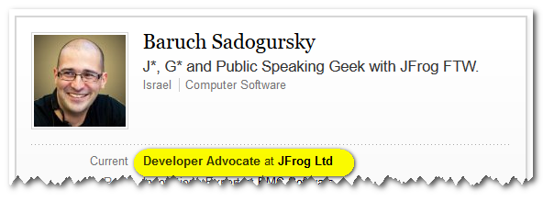
Who's speaking?
@jbaruch
github.com/jbaruch
linkd.in/jbaruch
stackoverflow.com/users/402053/jbaruch

Slide 3



Viktor Gamov
@gamussa
Solutions Architect at Hazelcast
International Conferences speaker
Co-author of O’Reilly’s
«Enterprise Web Development»

Slide 4
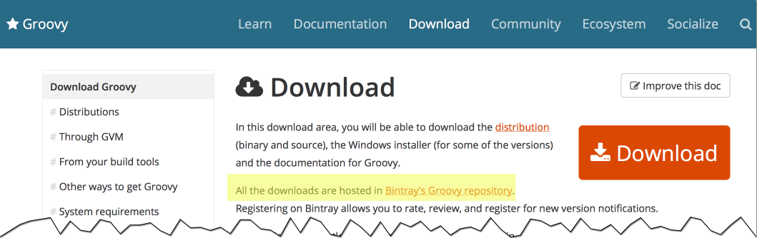
Frogs ❤️ Groovy

Slide 5

Frogs ❤️ Groovy
Hosting Groovy on Bintray
Hosting Groovy on Artifactory
Bintray UI is Grails
Artifactory plugins are Groovy
Gradle and Grails plugins on Bintray

Slide 6
First Season Was a Blast!

Slide 7
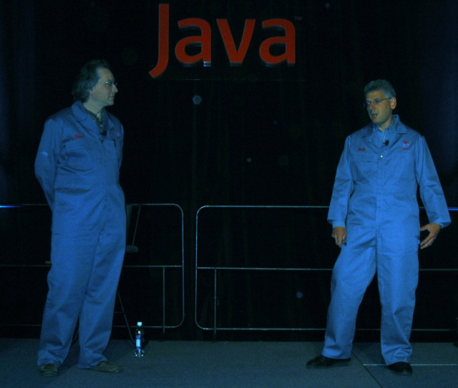
Click and hack
the typing brothers

Slide 8
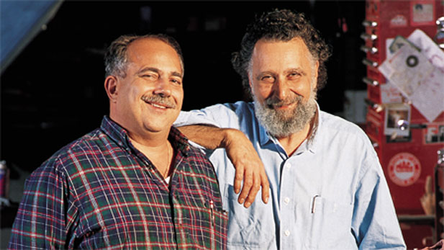
BTW,
Notes:
The Car Show (1977-2012) Click and Clack, the Tappet Brothers - Tom and Ray Magliozzi

Slide 9


Two entertaining guys on stage
Funny Puzzling questions
You think and vote
Awesome Groovy t-shirts fly in the air
Official twitter handle! groovypuzzlers
Notes:
CURRENT – JB
NEXT - FRED

Slide 10
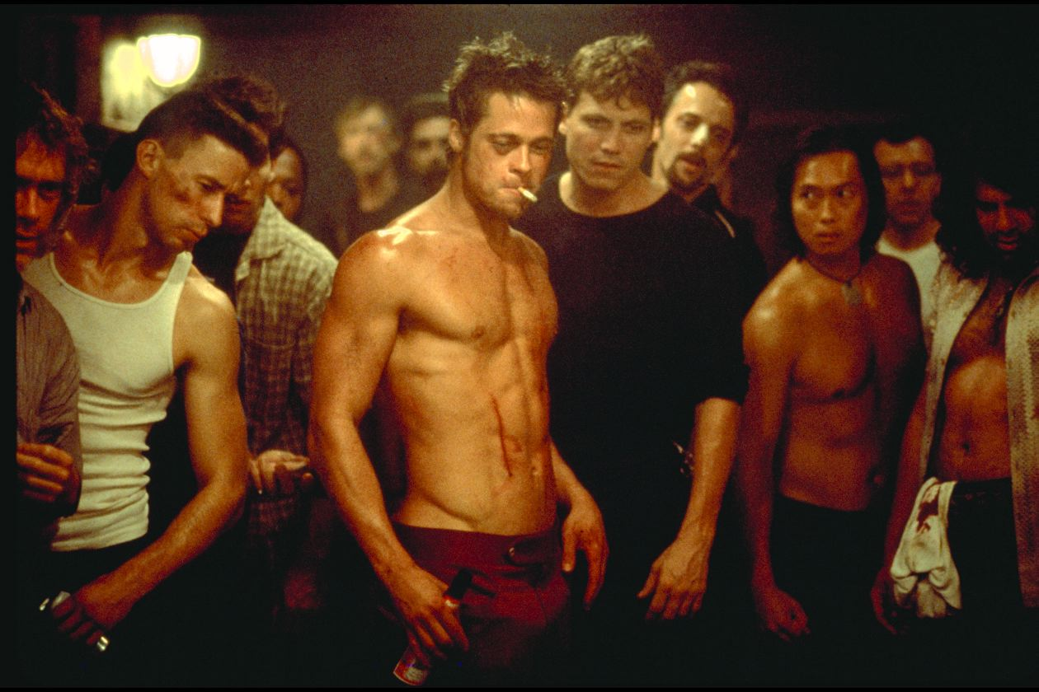
First rule of the puzzlers:
No cheating!
Notes:
CURRENT – JB
NEXT - FRED

Slide 11

All works (or doesn't work) in Groovy 2.4.5
Notes:
CURRENT – YOAV
NEXT - JB

Slide 12

Notes:
CURRENT – YOAV
NEXT - JB

Slide 13
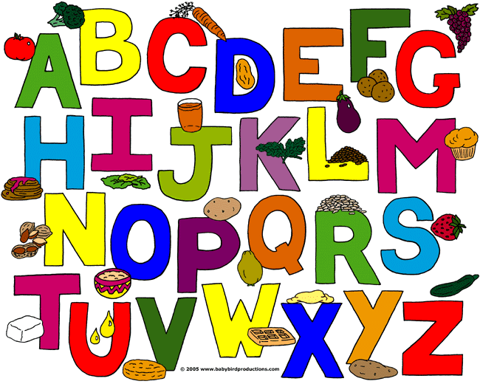

Slide 14

'a'..'z'.each { println it }
NoSuchMethodError
z
Won’t run
a b c . . . z

Slide 15


Slide 16
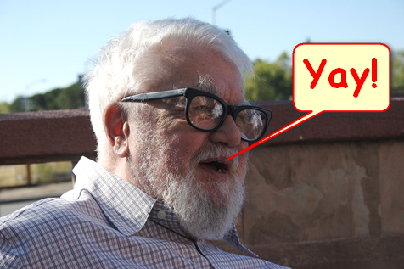
('a'..'z').each { println it }
You knew it, right?

Slide 17
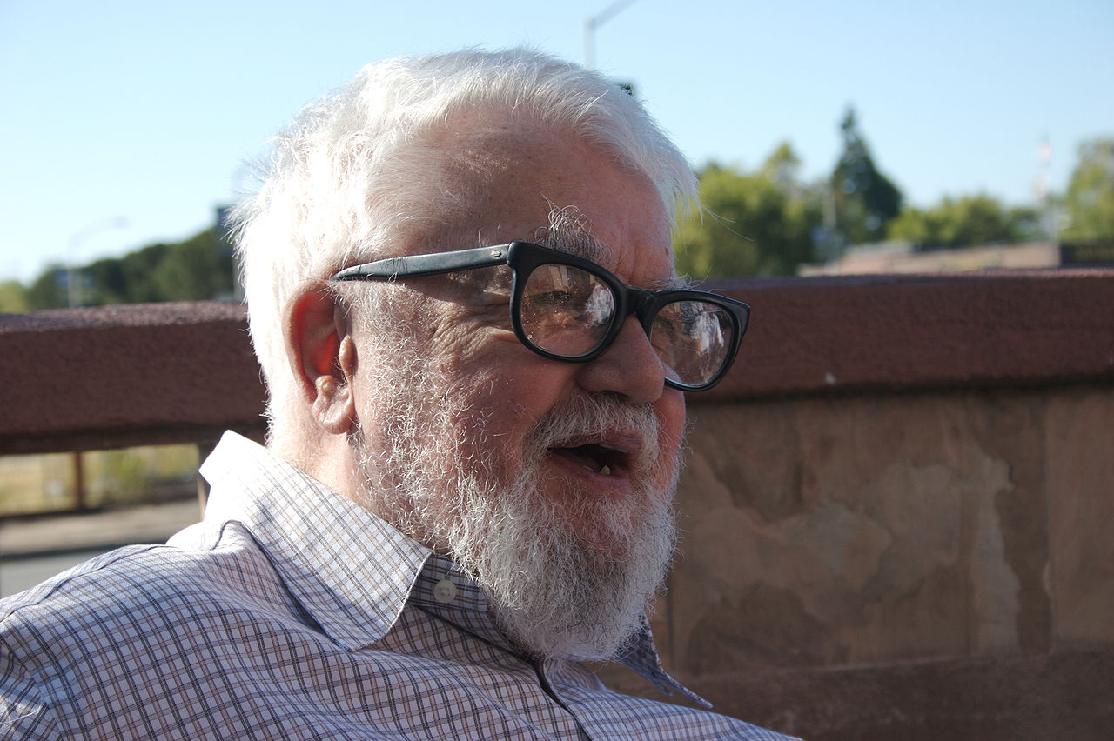
“All problems in computer science can be solved by another pair of parentheses”
John McCarthy, the inventor of LISP

Slide 18

And the t-shirt goes to…
Notes:
CURRENT – FRED
NEXT - JB

Slide 20
How Many Bachs?
def back = 'back' def quotes = ["I'll be $back",
"I'll be ${-> back}",
"I'll be ${back}",
"I'll be "+back] println quotes back = 'Bach' println quotes
No Bachs
One Bach
Two Bachs
Three Bachs
Notes:
Cedric

Slide 21


Slide 22
Only closures are evaluated at runtime Others are inlined

Slide 23
Only closures are evaluated at runtime Others are inlined
def back = 'back' def quotes = ["I'll be $back",
"I'll be ${-> back}",
"I'll be ${back}",
"I'll be "+back]
Notes:
Cedric

Slide 24
Only closures are evaluated at runtime Others are inlined
def back = 'back' def quotes = ["I'll be $back",
"I'll be ${-> back}",
"I'll be ${back}",
"I'll be "+back]
That is the only closure
Notes:
Cedric

Slide 25

And the t-shirt goes to…

Slide 26


Slide 27


Slide 28
How one prints 666?
def beast = '6' * Math.PI
def beast = '6' * '3'
def beast = '667' – 1
def beast = '6' + '6' + 0 + 6

Slide 29
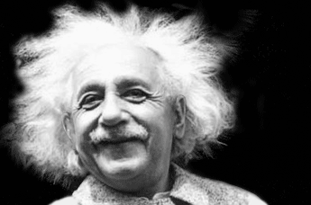

Slide 30
def beast = '6' * Math.PI

Slide 31
def beast = '6' * 3.1415926…

Slide 32
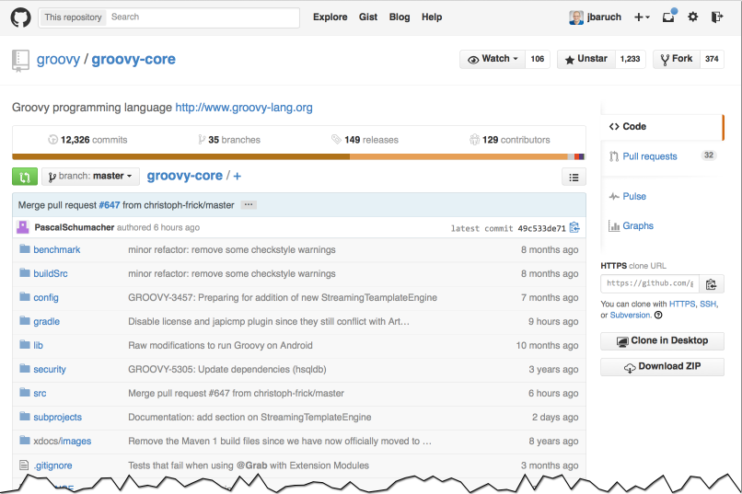

Slide 33
/** * Repeat a String a certain number of times. * * @param self a String to be repeated * @param factor the number of times the String should be repeated * @return a String composed of a repetition * @throws IllegalArgumentException if the number of repetitions is &lt; 0 * @since 1.0 */ public static String multiply(String self, Number factor) { int size = factor.intValue(); … }

Slide 34
def beast = '6' * 3.1415926…

Slide 35
def beast = '6' * 3

Slide 36
Pop Quiz!
def beast = '6' * '3'
def beast = '667' – 1
def beast = '6' + '6' + 0 + 6

Slide 37
Pop Quiz!
def beast = '6' * '3'
def beast = '667' – 1
def beast = '6' + '6' + (0 + 6)

Slide 38
Pop Quiz!
def beast = '6' * '3'
def beast = '667' – 1
def beast = '6' + '6' + (0 + 6)
Yup, I am watching you!

Slide 39

And the t-shirt goes to…

Slide 41
class THERE_CAN_BE_ONLY_ONE { }
class MacLeod { THERE_CAN_BE_ONLY_ONE getTHERE_CAN_BE_ONLY_ONE() { Class clazz = THERE_CAN_BE_ONLY_ONE return clazz.newInstance() } } println new MacLeod().THERE_CAN_BE_ONLY_ONE
Notes:
@tolkv

Slide 42
class THERE_CAN_BE_ONLY_ONE { }
class MacLeod {
THERE_CAN_BE_ONLY_ONE getTHERE_CAN_BE_ONLY_ONE() {
Class clazz = THERE_CAN_BE_ONLY_ONE
return clazz.newInstance()
}
}
println new MacLeod().THERE_CAN_BE_ONLY_ONE
Won't start
No such property: THERE_CAN_BE_ONLY_ONE for class: MacLeod
THERE_CAN_BE_ONLY_ONE@3d74bf60
Another Exception
Notes:
@tolkv

Slide 43


Slide 44
MultipleCompilationErrorsException
StackOverflowError
NullPointerException
Yet Another Exception

Slide 46
class MacLeod {
THERE_CAN_BE_ONLY_ONE getTHERE_CAN_BE_ONLY_ONE() {
Class clazz = THERE_CAN_BE_ONLY_ONE
return clazz.newInstance()
}
}
Notes:
@tolkv

Slide 47
class MacLeod {
THERE_CAN_BE_ONLY_ONE getTHERE_CAN_BE_ONLY_ONE() {
Class clazz = getTHERE_CAN_BE_ONLY_ONE()
return clazz.newInstance()
}
}

Slide 48
Let's Fix It!
Class<THERE_CAN_BE_ONLY_ONE> clazz = THERE_CAN_BE_ONLY_ONE.class

Slide 49
class MacLeod {
THERE_CAN_BE_ONLY_ONE getTHERE_CAN_BE_ONLY_ONE() {
Class<THERE_CAN_BE_ONLY_ONE> clazz = THERE_CAN_BE_ONLY_ONE.class
return clazz.newInstance()
}
}
Notes:
@tolkv

Slide 51
class MacLeod {
THERE_CAN_BE_ONLY_ONE getTHERE_CAN_BE_ONLY_ONE() {
Class<THERE_CAN_BE_ONLY_ONE> clazz = getTHERE_CAN_BE_ONLY_ONE().class
return clazz.newInstance()
}
}
Notes:
@tolkv

Slide 52
Let's Fix It!
Class<THERE_CAN_BE_ONLY_ONE> clazz = (THERE_CAN_BE_ONLY_ONE as Class)

Slide 53
class MacLeod {
THERE_CAN_BE_ONLY_ONE getTHERE_CAN_BE_ONLY_ONE() {
Class<THERE_CAN_BE_ONLY_ONE> clazz = (THERE_CAN_BE_ONLY_ONE as Class)
return clazz.newInstance()
}
}
Notes:
@tolkv

Slide 55
class MacLeod {
THERE_CAN_BE_ONLY_ONE getTHERE_CAN_BE_ONLY_ONE() {
Class<THERE_CAN_BE_ONLY_ONE> clazz = (getTHERE_CAN_BE_ONLY_ONE() as Class)
return clazz.newInstance()
}
}
Notes:
@tolkv

Slide 56
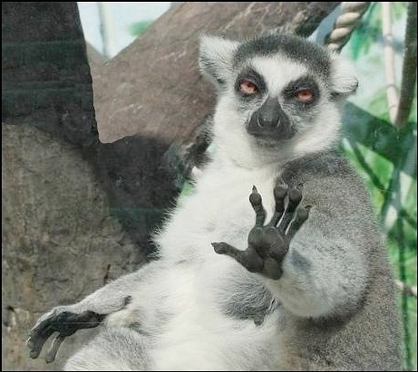
Let's Fix It!
Relax.
Don't shout.

Slide 57

And the t-shirt goes to…

Slide 58
Missed me?

Slide 59
@groovy.transform.InheritConstructors class TreaayeMap extends HashMap { } TreaayeMap a = [5] TreaayeMap b = [6] println "${a.getClass()} ${a.equals(b)}"
class HashMap true
class TreaayeMap false
class TreaayeMap true
class HashMap false
Notes:
https://github.com/SerCeMan

Slide 60


Slide 61


Slide 62
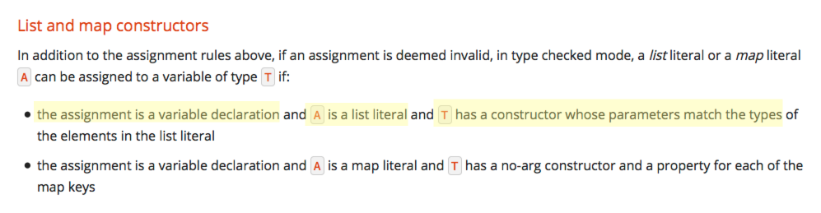

Slide 63
TreaayeMap a = [5]

Slide 64
TreaayeMap a = [5]

Slide 65
TreaayeMap a = [5]

Slide 66
@groovy.transform.InheritConstructors class TreaayeMap extends HashMap { }
TreaayeMap a = [5]

Slide 67
/** * Constructs an empty <tt>HashMap</tt> with the specified initial * capacity and the default load factor (0.75). * * @param initialCapacity the initial capacity. * @throws IllegalArgumentException if the initial capacity is negative. */ public HashMap(int initialCapacity)
@groovy.transform.InheritConstructors class TreaayeMap extends HashMap { }
TreaayeMap a = [5]

Slide 68
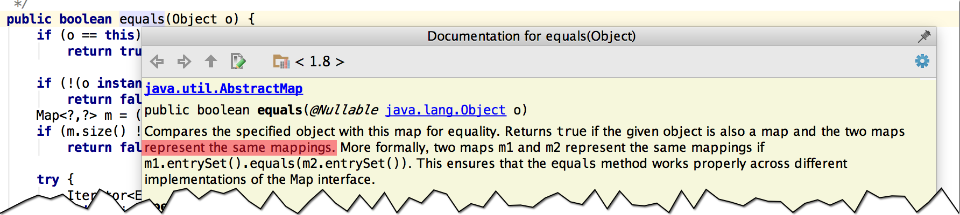
equals() doesn’t care about capacity, mappings only

Slide 69

And the t-shirt goes to…

Slide 70

Collect
All the elements!

Slide 71
class Kitty { def fur } def kitties = [new Kitty(fur: 'soft'),new Kitty(fur: 'warm'),new Kitty(fur: 'purr') ] println kitties.collect { it.fur } println kitties*.fur println kitties.fur
How many of the printed lines will be the same?
All different
2 similar, one different
All the same
Won't run

Slide 72


Slide 73
class Kitty { def fur } def kitties println kitties.collect { it.fur } println kitties*.fur println kitties.fur
How many of the printed lines will be the same?
All different
2 similar, one different
All the same
Won't compile

Slide 74


Slide 75
class Kitty { def fur } def kitties
println kitties.fur

Slide 76

class Kitty { def fur } def kitties
println kitties.fur

Slide 77
class Kitty { def fur } def kitties println kitties.collect { it.fur }

Slide 78
class Kitty { def fur } def kitties println kitties.collect { it.fur }

Slide 79
class Kitty { def fur } def kitties println kitties.collect { it.fur }

Slide 80
class Kitty { def fur } def kitties println kitties.collect { it.fur }
public static <T> List<T> collect(Object self, Closure<T> transform) { Collection collection = self.asCollection()
…
}

Slide 81
class Kitty { def fur } def kitties println kitties.collect { it.fur }
public static Collection asCollection(Object self) { if (self == null) { return Collections.EMPTY_LIST; }
…
}

Slide 82
class Kitty { def fur } def kitties println kitties*.fur

Slide 83
class Kitty { def fur } def kitties println kitties*.fur

Slide 84
class Kitty { def fur } def kitties println kitties*.fur

Slide 85
Consistency, yeah.
[]
null
Caught: java.lang.NullPointerException: Cannot get property 'fur' on null object

Slide 86
“All happy families are alike; each unhappy family is unhappy in its own way.”
Leo Tolstoy, “Anna Karenina”

Slide 87

And the t-shirt goes to…

Slide 88


Slide 89
ArrayList<String> expendables = ['Arnold', 'Chuck', Sly'] def expendable = //someone from the list for(String hero in expendables) { if(hero == expendable){ expendables.remove(hero) } } println expendables

Slide 90
Which one won’t cause a ConcurrentModificationException?
ArrayList<String> expendables = ['Arnold', 'Chuck', Sly'] def expendable = //someone from the list for(String hero in expendables) { if(hero == expendable){ expendables.remove(hero) } } println expendables
Can't avoid CME
Arnold
Chuck
Sly

Slide 91



Slide 92

ConcurrentModificationException?
Nope, Never heard about it.

Slide 93
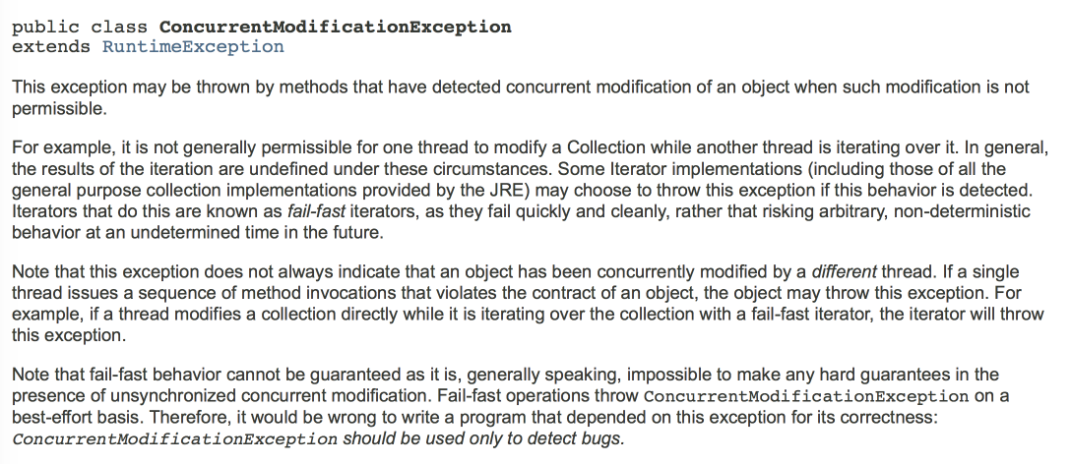
You have been warned.

Slide 94
Let’s decompile this, baby!
List expendables = Arrays.asList(new String[]{"Arnold", "Chuck", " Sly"}); String expendable = "Chuck"; Iterator iterator = expendables.iterator(); while(iterator.hasNext()) { String hero = (String)iterator.next(); if(hero.equals(expendable)) { expendables.remove(hero); } }

Slide 95
while(iterator.hasNext()) { String hero = (String)iterator.next(); if(hero.equals(expendable)) { // expendables.remove(hero); } }

Slide 96
while(iterator.hasNext()) { String hero = (String)iterator.next(); if(hero.equals(expendable)) { // expendables.remove(hero); } }
Modifications are only checked in the next cycle
public E next() { checkForComodification(); …
cursor = i + 1; }
Getting ready for hasNext() check in the next cycle
public boolean hasNext() { return cursor != size(); }
Exit on last element +1 == size()

Slide 97
while(iterator.hasNext()) { String hero = (String)iterator.next(); if(hero.equals(expendable)) { // expendables.remove(hero); } }
public E next() { checkForComodification(); …
cursor = i + 1; }
After Sly cursor is 3
public boolean hasNext() { return cursor != size(); }
And size is 3 as well
All good. Now let’s mess with it.
Notes:
Normal operation: exists after element 2, when cursor is already 3 and size is 3

Slide 98
while(iterator.hasNext()) { String hero = (String)iterator.next(); if(hero.equals(expendable)) { expendables.remove(hero); } }
public E next() { checkForComodification(); …
cursor = i + 1; }
After Chuck the cursor is 2
Then we remove the element
public boolean hasNext() { return cursor != size(); }
And now the size now is 2!
It won’t get to the next() to run checkForComodification!
Notes:
With deletion exits after 2, because cursor is on 2 and size became 2!

Slide 99

Hey, what about me?!

Slide 100
while(iterator.hasNext()) { String hero = (String)iterator.next(); if(hero.equals(expendable)) { expendables.remove(hero); } }
public E next() { checkForComodification(); …
cursor = i + 1; }
After Sly the cursor is 3
Then we remove the element
public boolean hasNext() { return cursor != size(); }
But the size now is 2!
It will go to another loop and fail on checkForComodification!
Notes:
With deletion exits after 2, because cursor is on 2 and size became 2!

Slide 101

Yup, you just saw the most awful puzzler. And it’s not even Groovy.

Slide 102

And the t-shirt goes to…

Slide 104
String truth = 'false' boolean groovyTruth = truth println groovyTruth
Notes:
@@AndreyHihlovski

Slide 105
String truth = 'false' boolean groovyTruth = truth println groovyTruth
false
true
ClassCastException
Startup error
Notes:
@@AndreyHihlovski

Slide 106


Slide 108

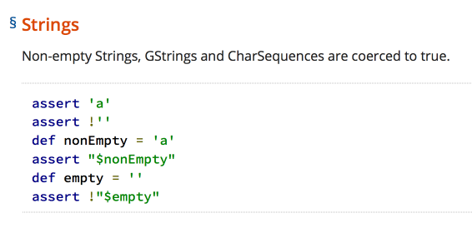

Slide 109
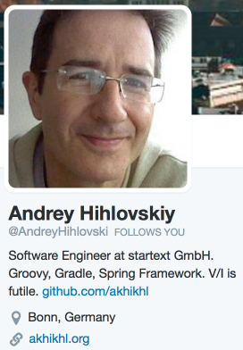
And the t-shirt goes to…

Slide 111
assert 1L == 1 println 1L.equals(1)
Assertion failed
true
false
MissingMethodException

Slide 112


Slide 114
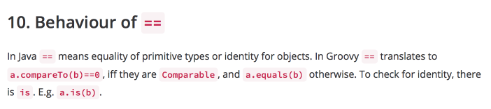

Slide 116

And the t-shirt goes to…

Slide 117


Slide 119
[[2, 3, 5], [2, 4, 8], [42, 73, 2147483647, 0]]
Won't run
[[null, null, null, 5]]
null

Slide 120


Slide 123
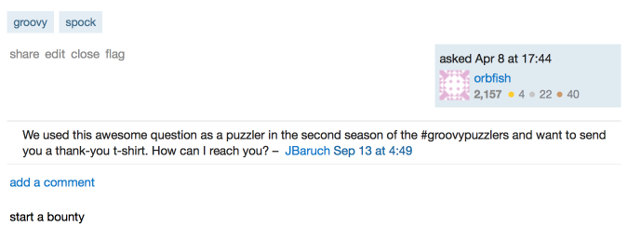
No t-shirt for this guy ☹

Slide 125
def jailhouseRock def loveMeTender def rockAroundTheClock = [1,2,3] jailhouseRock?:[] + loveMeTender?:[] + rockAroundTheClock?:[]
*Yes, we know, it's not Elvis' song.
Notes:
Bill Haley

Slide 126
def jailhouseRock def loveMeTender def rockAroundTheClock = [1,2,3] jailhouseRock?:[] + loveMeTender?:[] + rockAroundTheClock?:[]
[null]
null
[]
[1,2,3]

Slide 128
def jailhouseRock def loveMeTender def rockAroundTheClock = [1,2,3] jailhouseRock?:[] + loveMeTender?:[] + rockAroundTheClock?:[]

Slide 129
def jailhouseRock def loveMeTender def rockAroundTheClock = [1,2,3] jailhouseRock?:[null]?:[] + rockAroundTheClock?:[]

Slide 130
def jailhouseRock def loveMeTender def rockAroundTheClock = [1,2,3] jailhouseRock?:[null]?:[1,2,3]?:[]

Slide 131
def jailhouseRock def loveMeTender def rockAroundTheClock = [1,2,3] [null]

Slide 132
Let's fix it
(jailhouseRock?:[])+(loveMeTender?:[])+(rockAroundTheClock?:[])
Love me tender!

Slide 133

And the t-shirt goes to…

Slide 134

Conclusions

Slide 135
Write readable code
Comment neat tricks
Sometimes it is just a bug
Use static code analysis (intellij IDEA!)
Rtfm
Parentheses. Always use Parentheses.

Slide 136

We keep going! (Look at the awesome t-shirts!)
Puzzlers? Gotchas? Fetal position inducing behavior?
puzzlers jfrog.com
Groovypuzzlers

Slide 137
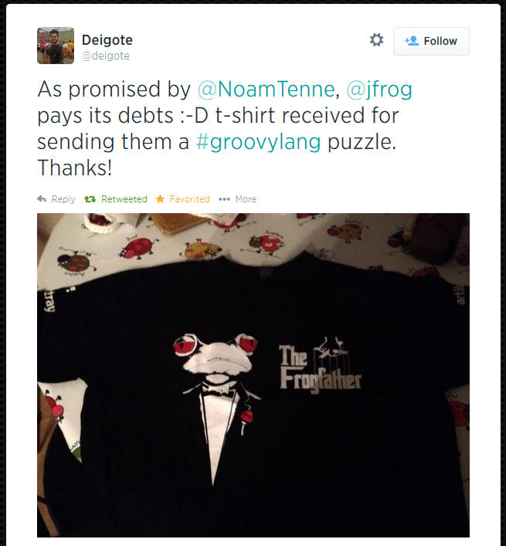
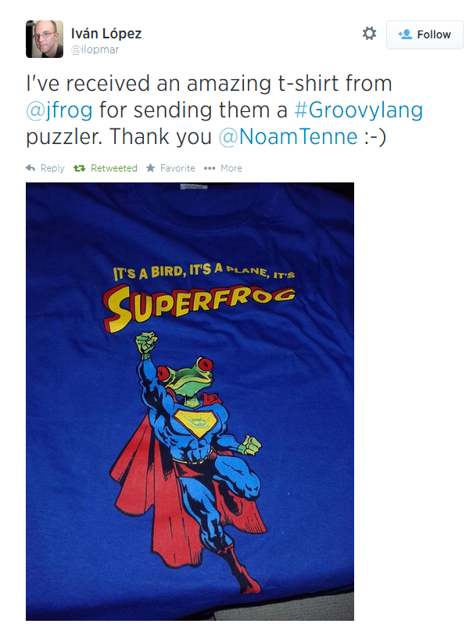
Jfrog always pays its debts

Slide 138
Positive feedback?
Fill the feedback form!
Praise us on twitter groovypuzzlers
Groovypuzzlers
gamussa
jbaruch
Negative feeback?
/dev/null

Slide 139

No, Thank you!

